Slide 1
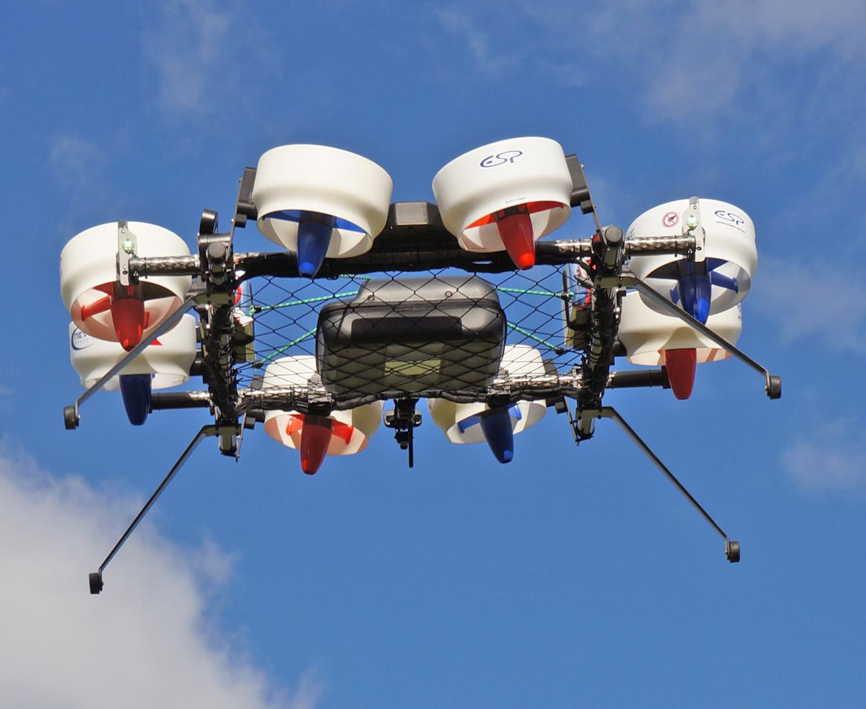
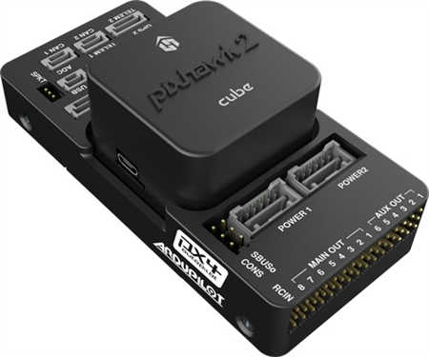
Wohler-b-MarkV-
WiringDiagram
Rev 1.2
By Valentin BERTRAND
2019/09/09

Slide 2
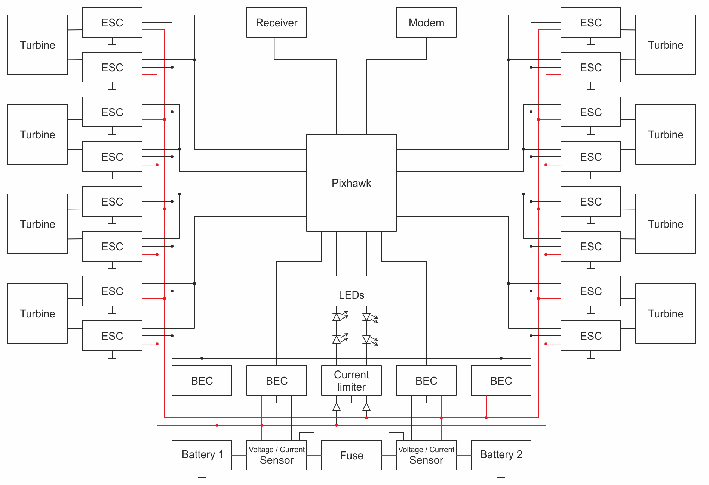
Full Main Circuit (PixHawk Circuit)

Slide 3
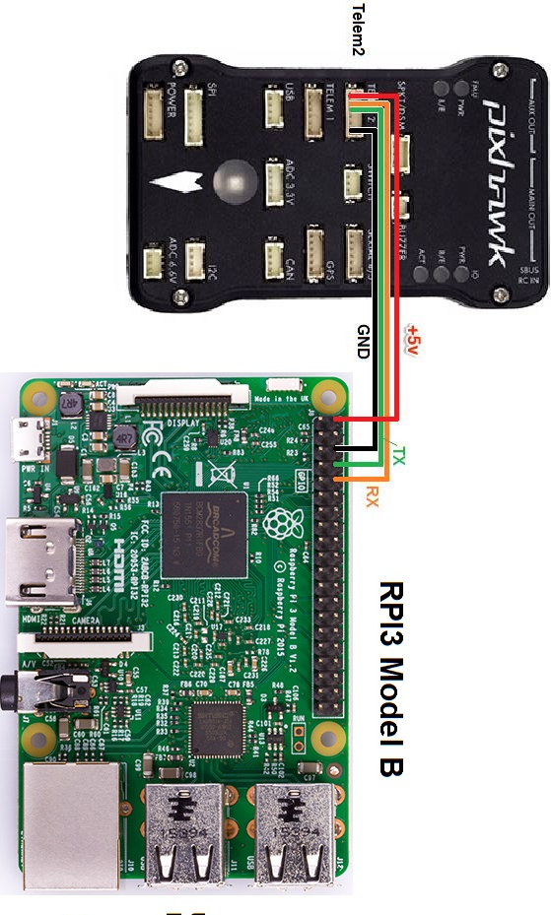
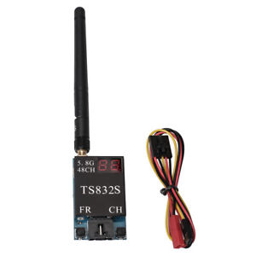
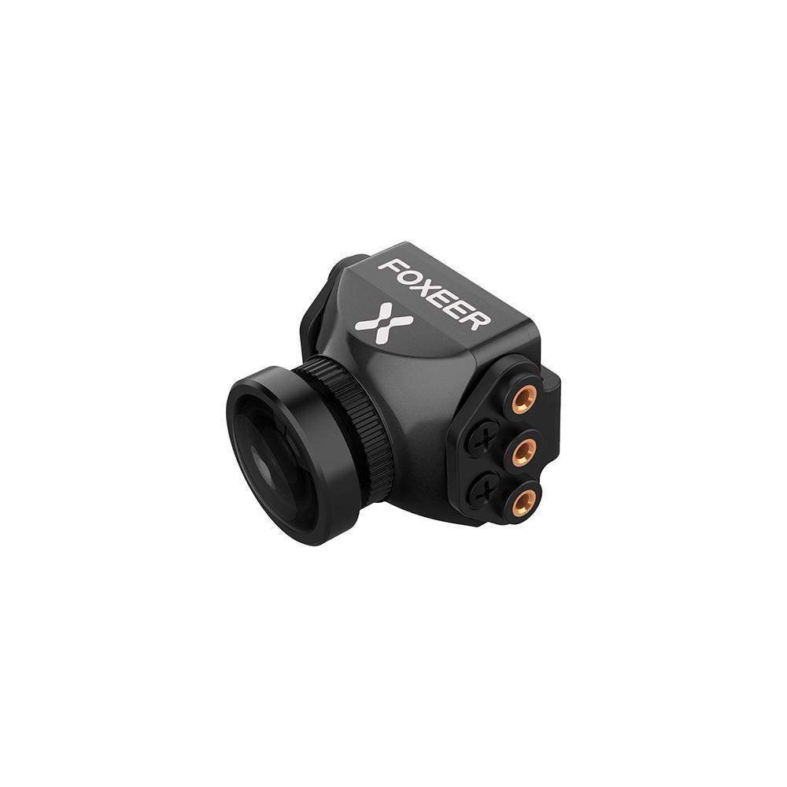
Auxiliary Circuit (Rasp, FPV TX...)
Video transmission diagram :
Castle BEC / 5V
UAS 22+ /12V
-> To Micro USB
Do not connect 5v in our case
TX TS832
TX TS832
Router 4G
Front Camera
Front camera
Back camera

Slide 4
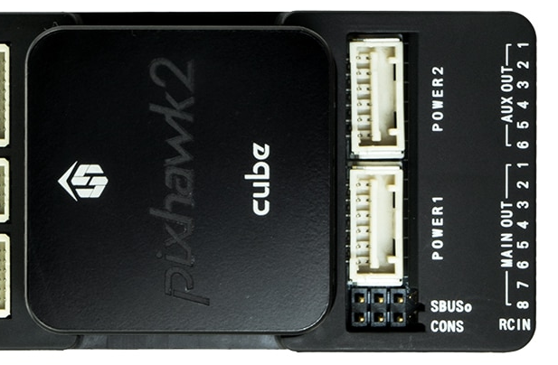
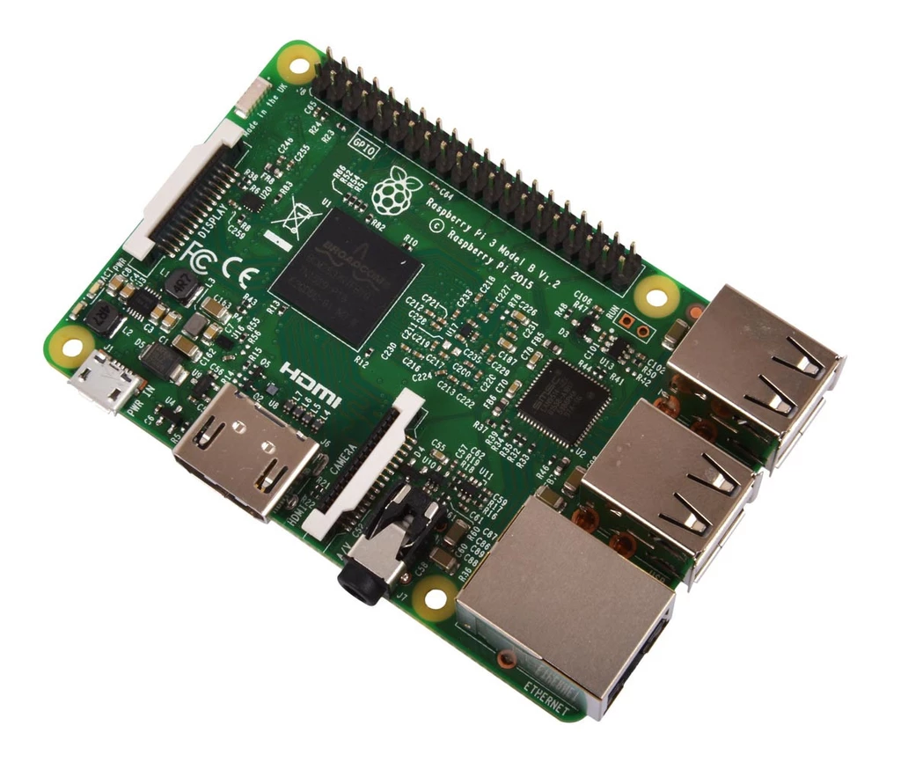
Detailed BEC Wiring
Bat 1
Bat 2
Block2
MAUCH BEC
Castle BEC 2.0
UAS 22+
LDD 300H
To LED
->To POWER2 / 5V
Not used
Block3
-> To Front FPV TX / 12V
-> To AUX5 / Power servo rail & PX / 5V
-> To AUX6 / Power servo rail & PX / 5V
-> To Back FPV TX / 12V
-> To Lighter / 12V
->To MicroUSB
->To POWER1 / 5V
MAUCH BEC
Castle BEC 2.0
UAS 22+
Block4
Castle BEC 2.0
Block5
Block1
Bat 1
Bat 2
All blocks have a dedicated box / Find box in : Fusion/Wohler-b-Mark-V/BEC Box.

Slide 5
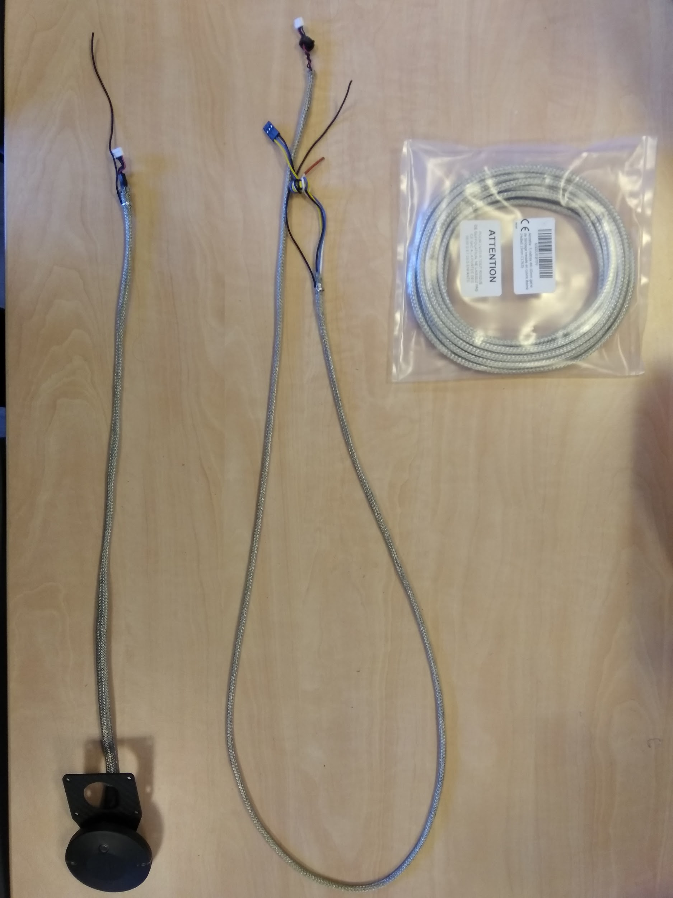
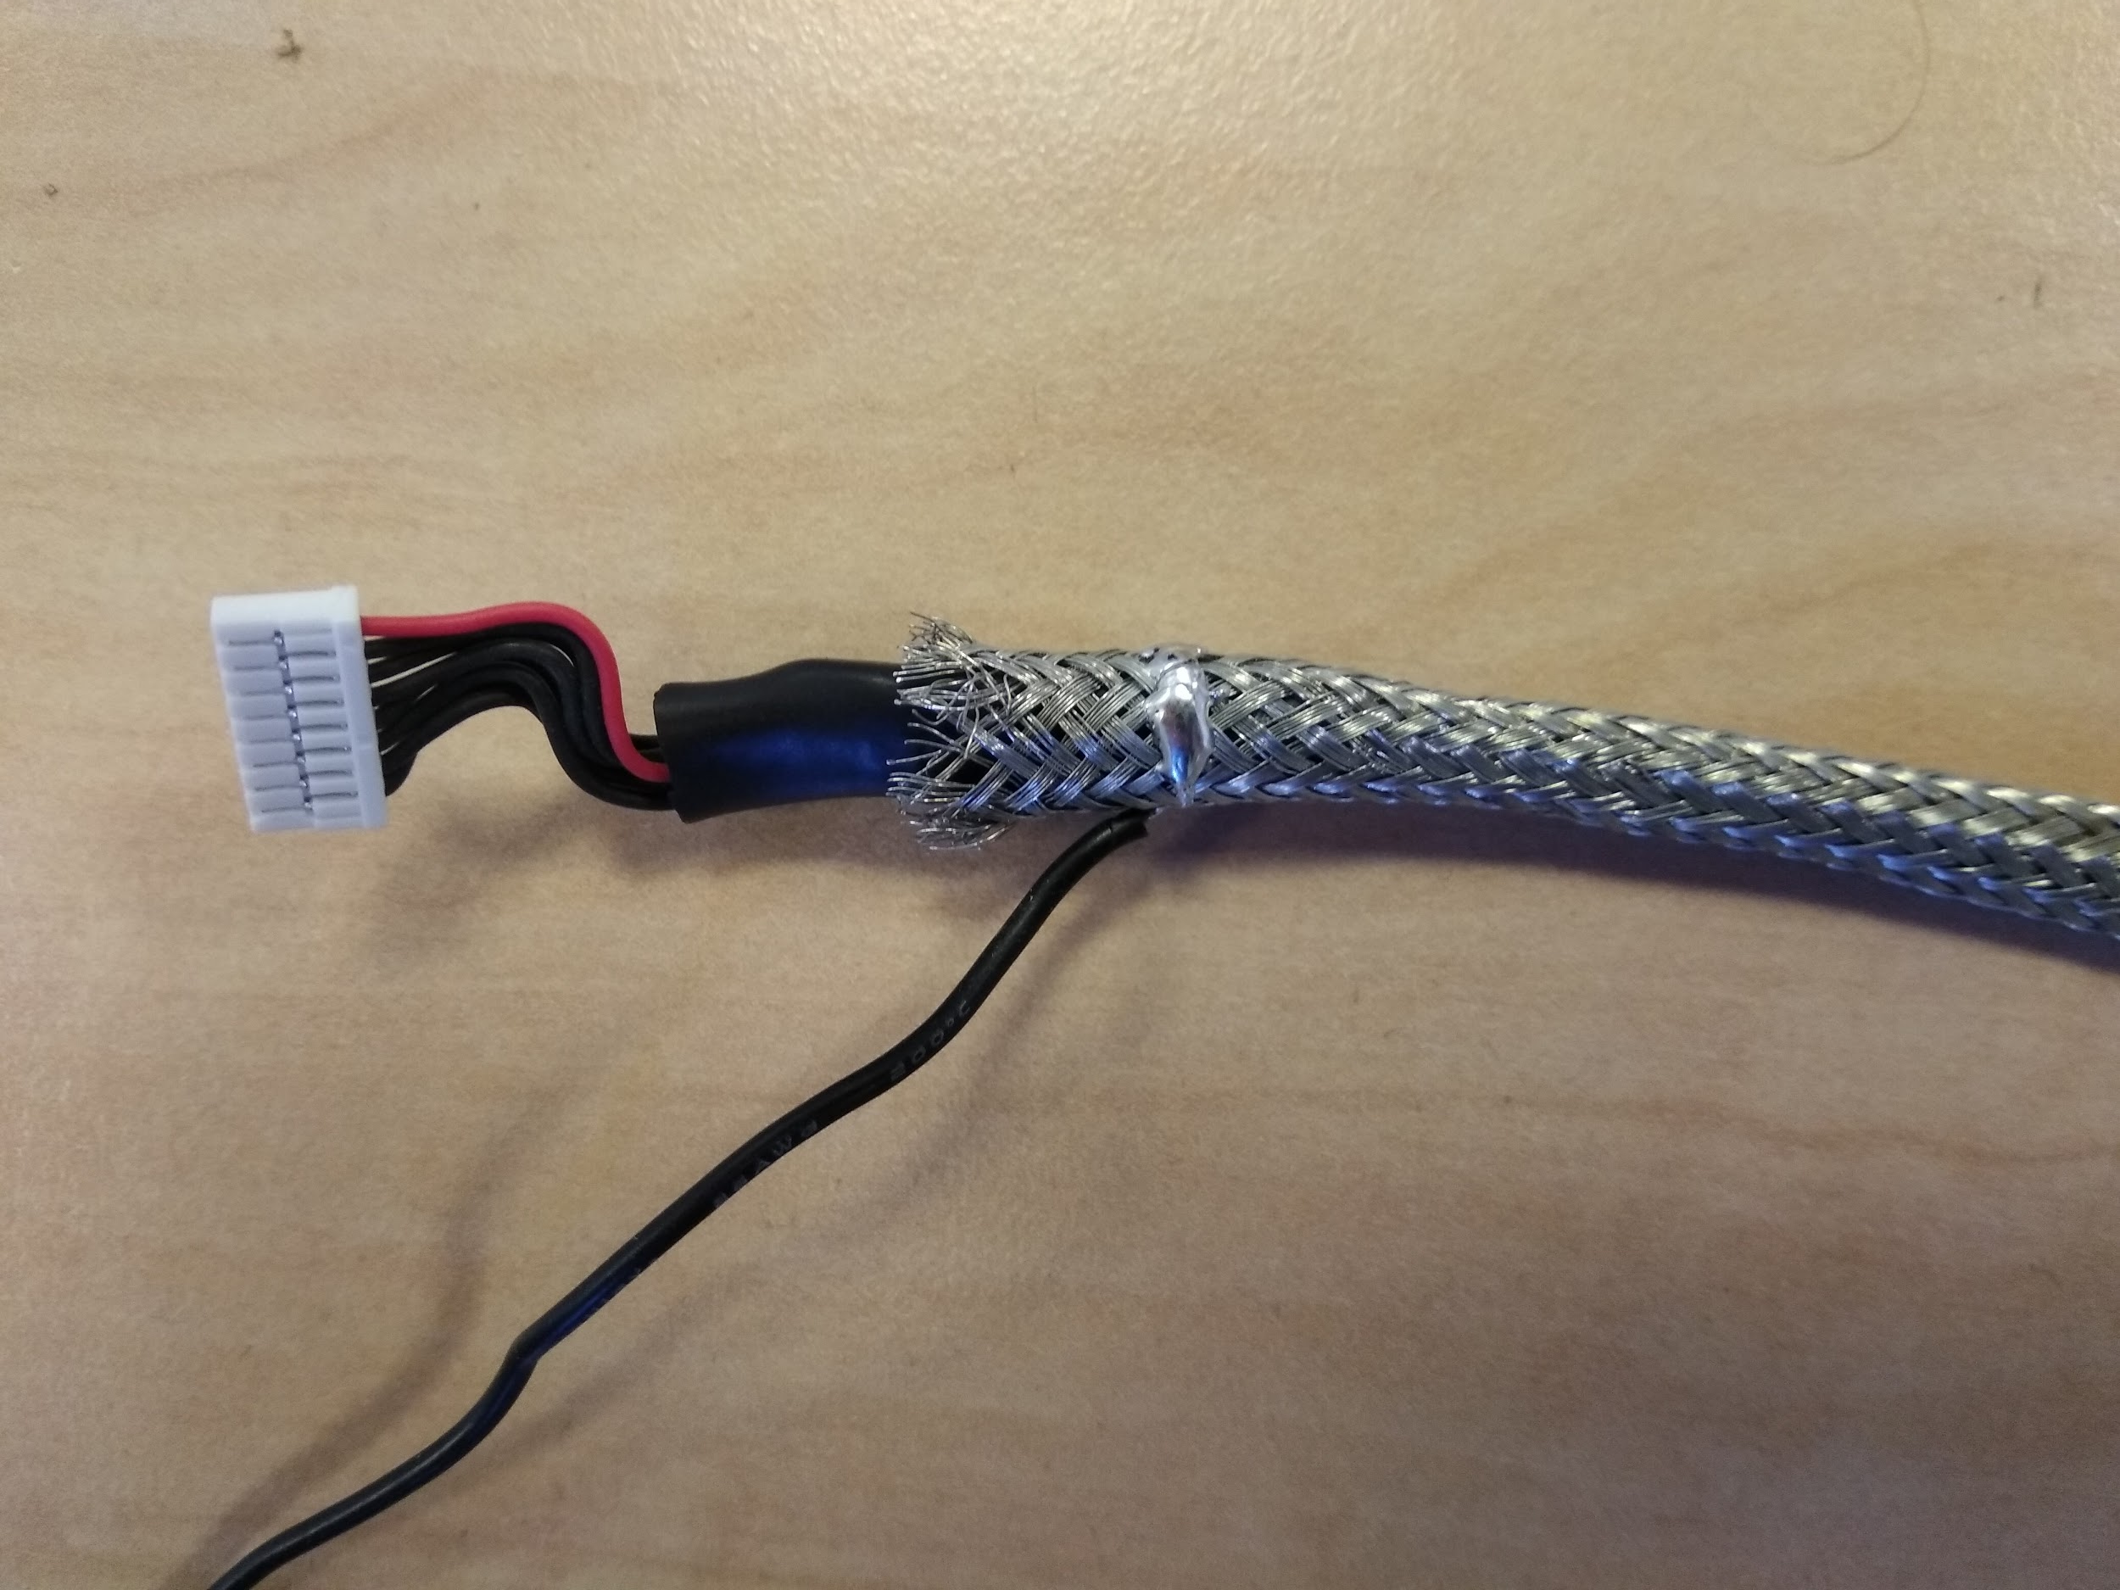
OEM / Electromagnetic Wave protection Part1
Tinned copper
braid
All data beams (gps and Telem1&2 ) have to be protected from OEM / Electromagnetic wave.
Use tinned copper braid to protect beam. One extremity of the braid has to be connected to the Battery GND.
Once the beam is in the braid, you must protect all the beam with cotton tape.
GPS beam
Telem2 beam
-> to the GND
Note : You must pass the beam in the braid before soldering any connector

Slide 6
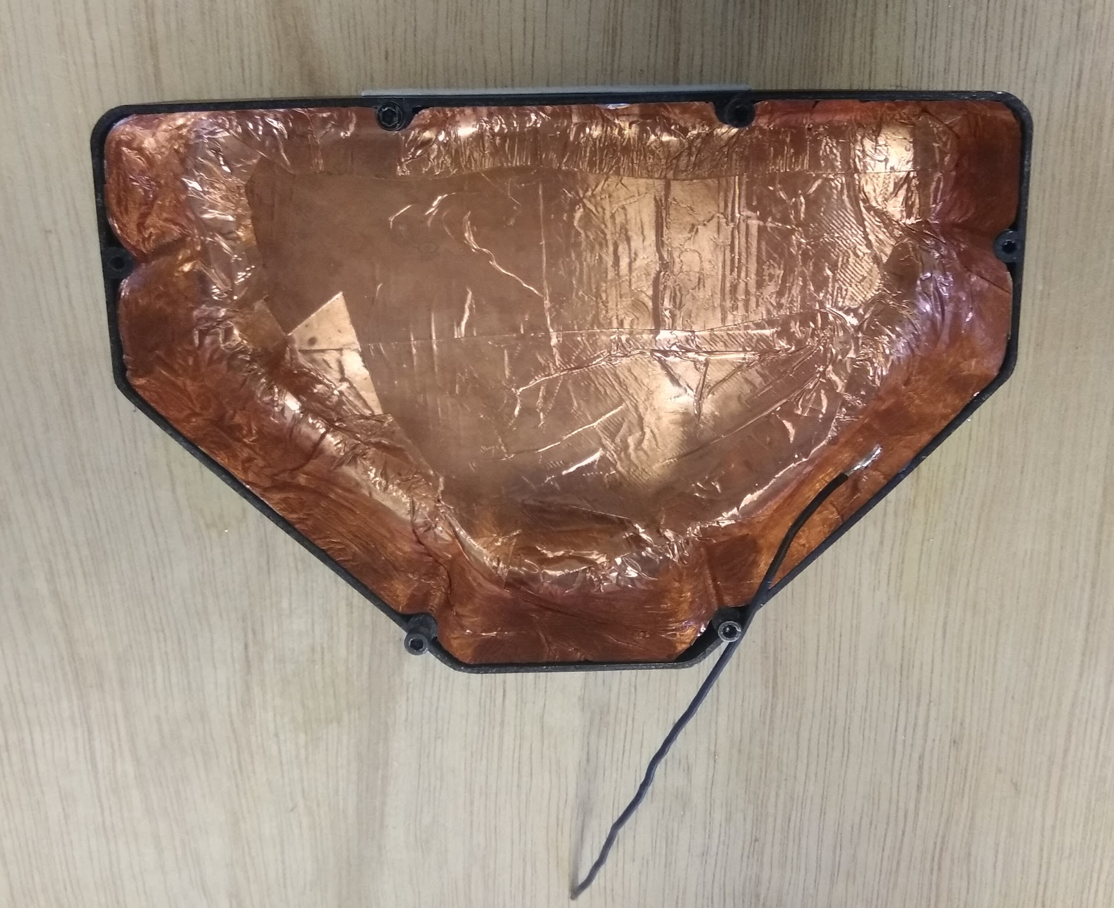
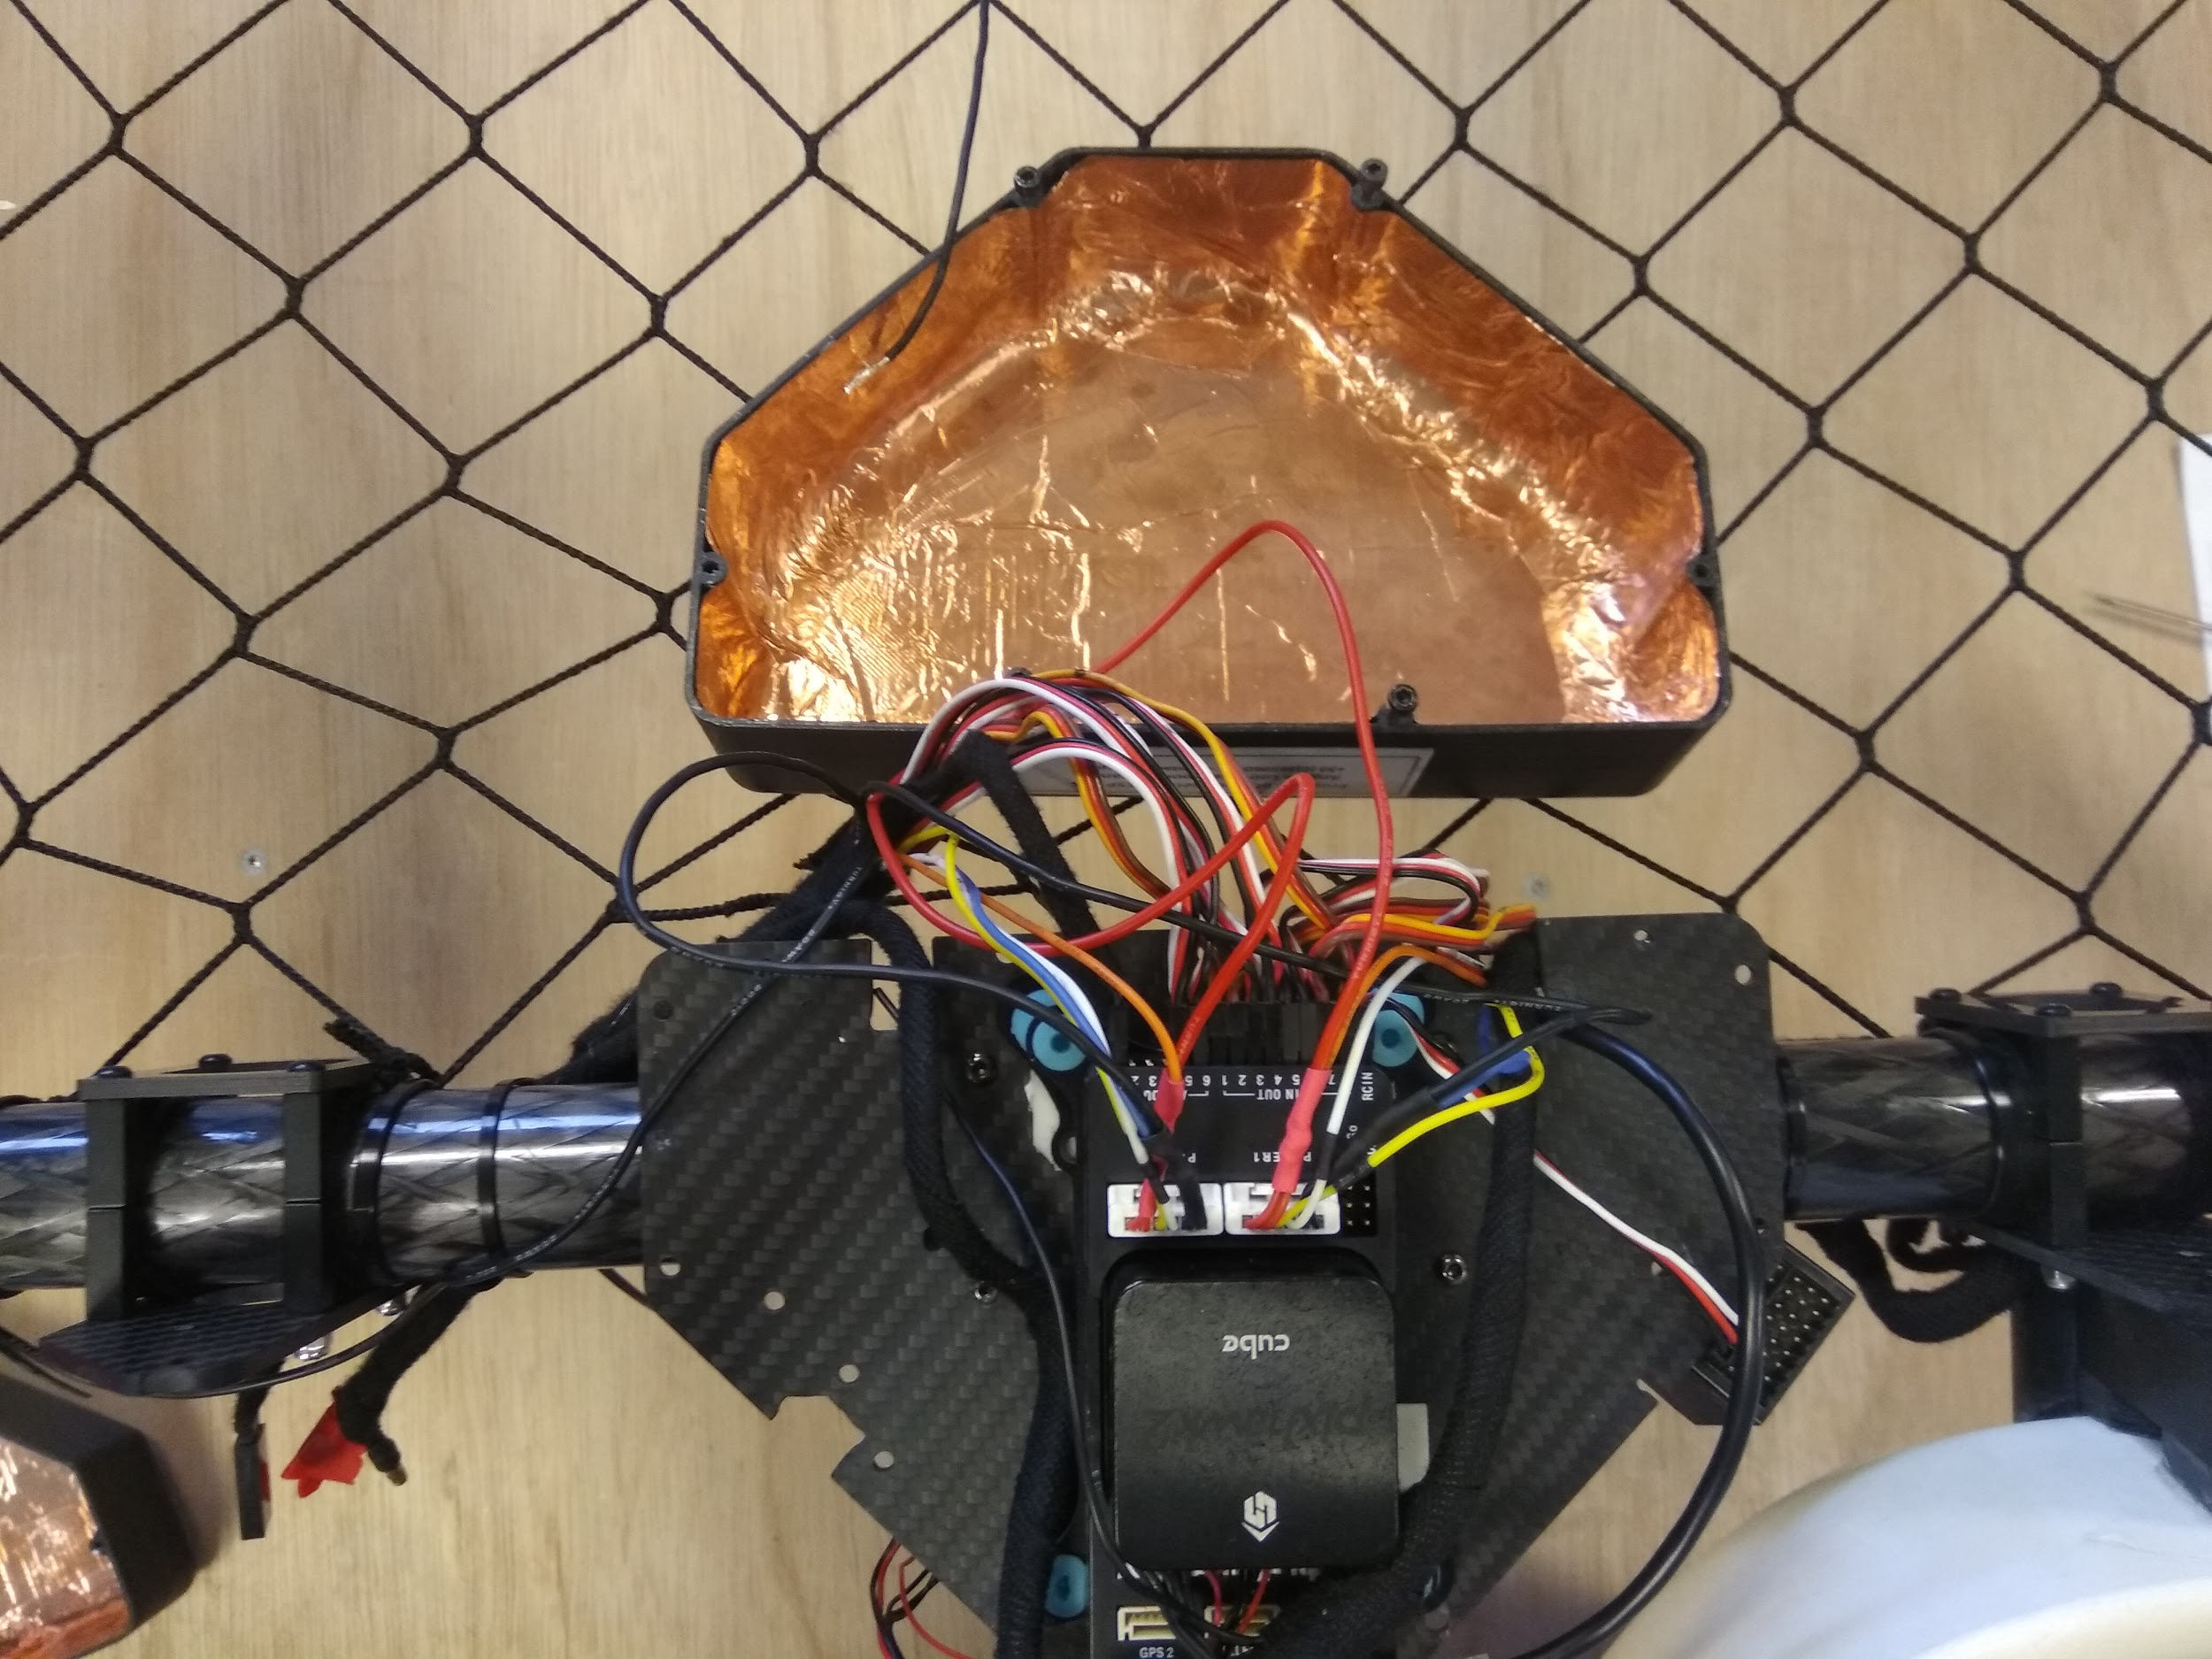
OEM / Electromagnetic Wave protection Part2
Autopilot and Companion computer have to be protected from OEM
Use copper tape to cover PixHawk box and RaspberryPi box
Then connect copper to the Battery GND
Be careful : place all antennas outside of the box
=> To battery GND

Slide 7
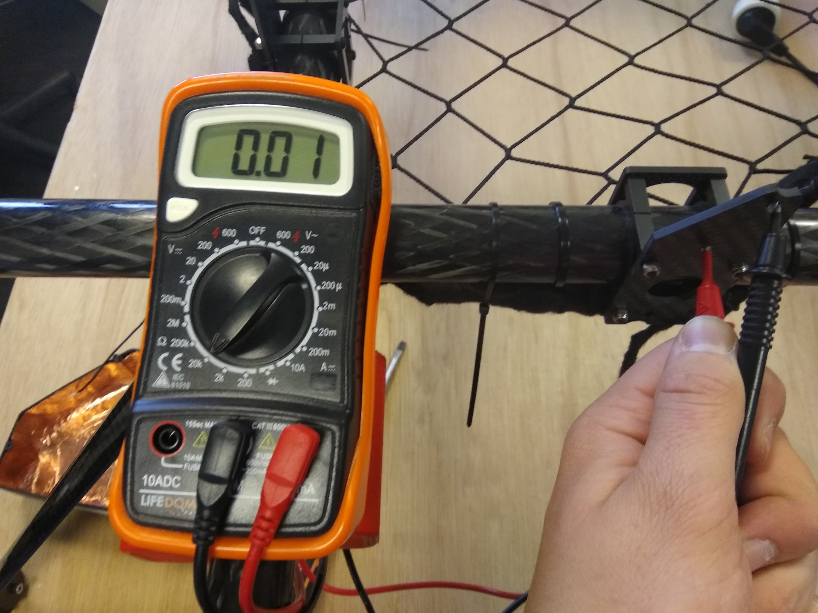
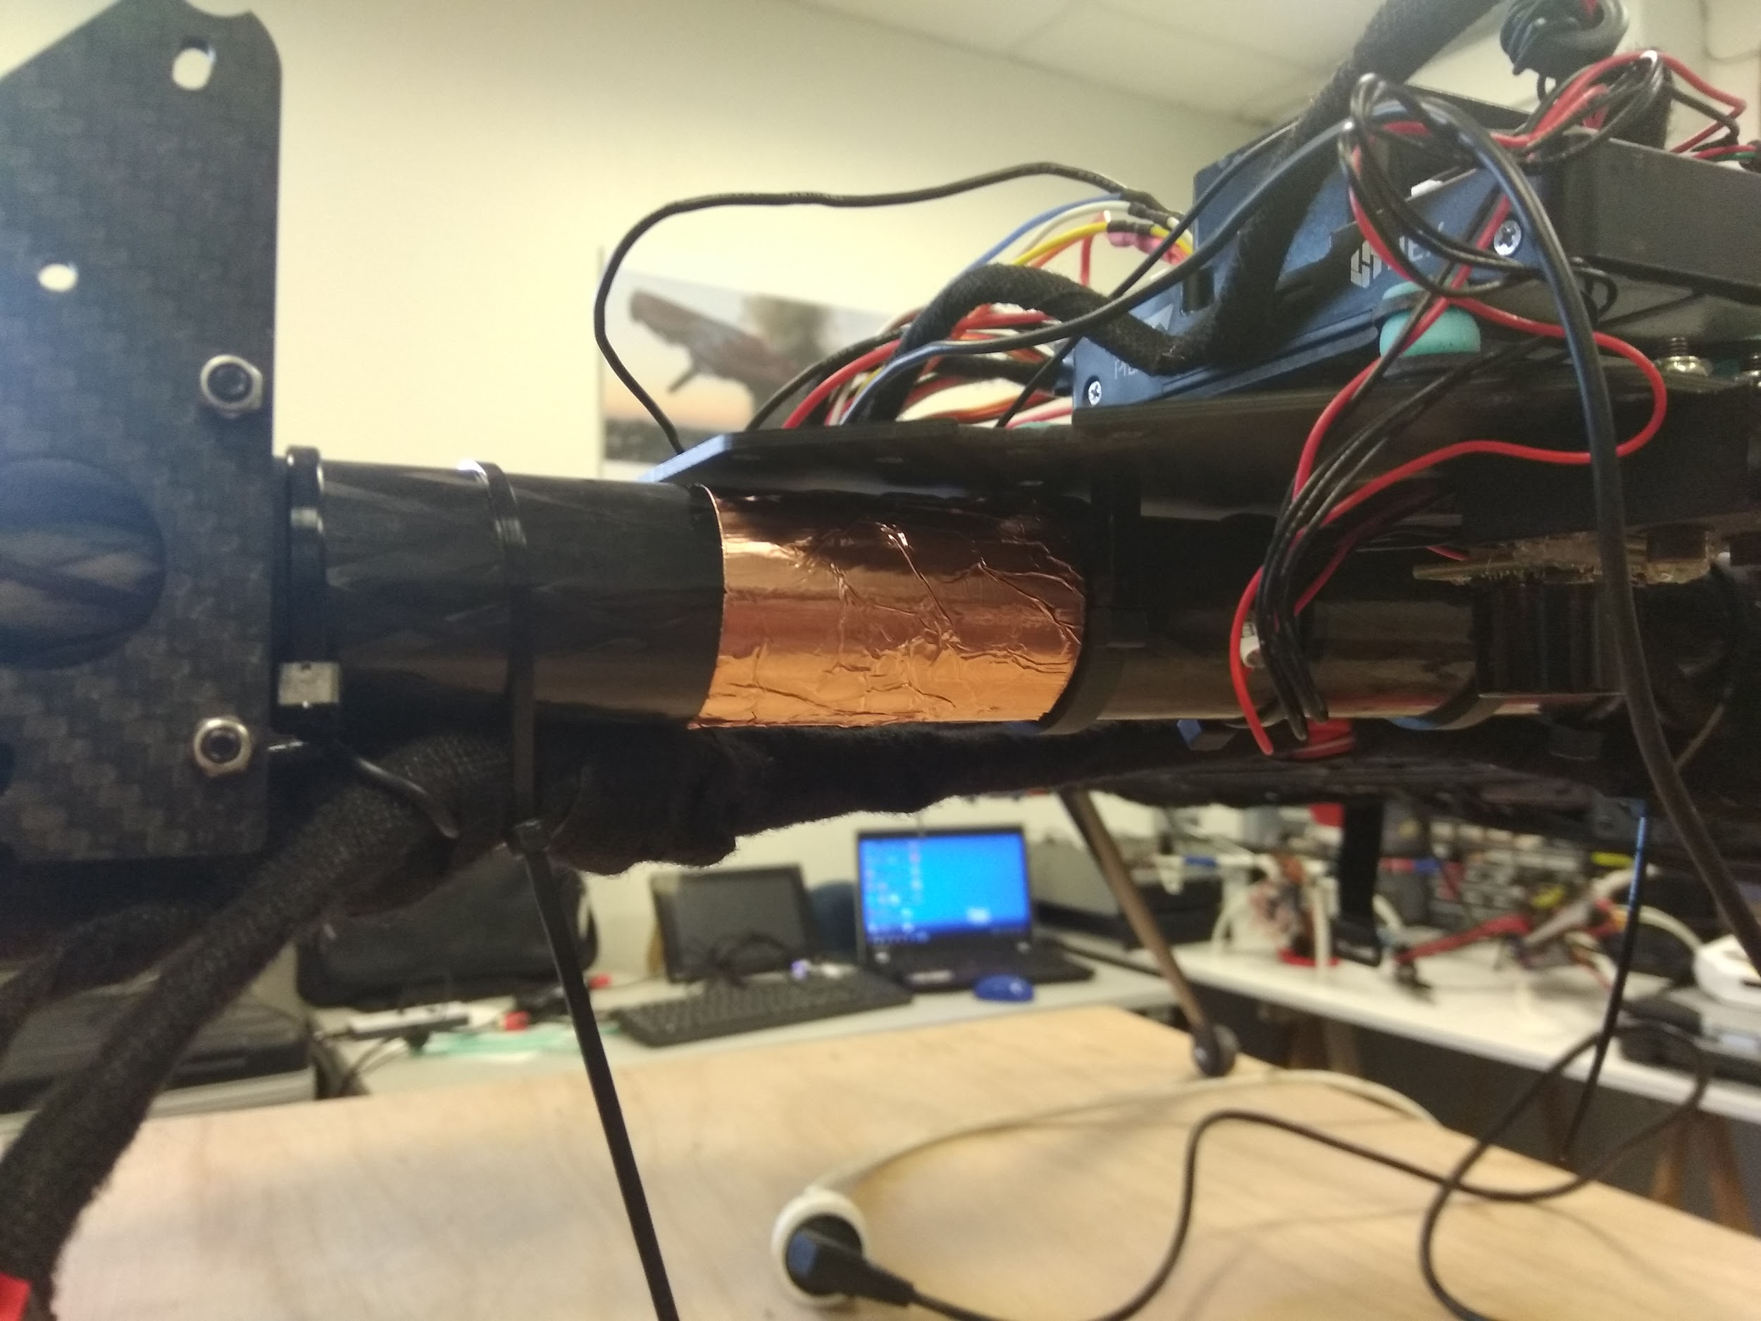
OEM / Electromagnetic Wave protection Part3
Because Carbon is conductive, we have to connect the frame to Battery GND
Wrap a section of the frame with copper tape, then connect copper to the GND
The place where you put the tape must be discreet, commonly below the PX box is a good place. You can use cotton tape to hide the copper tape.
Test of carbon conductivity
Connect copper tape to GND

